Slide 1

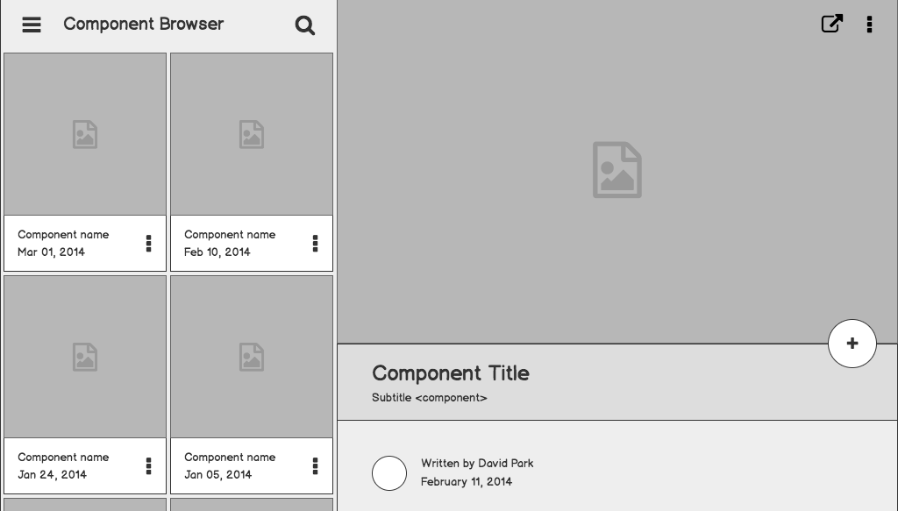

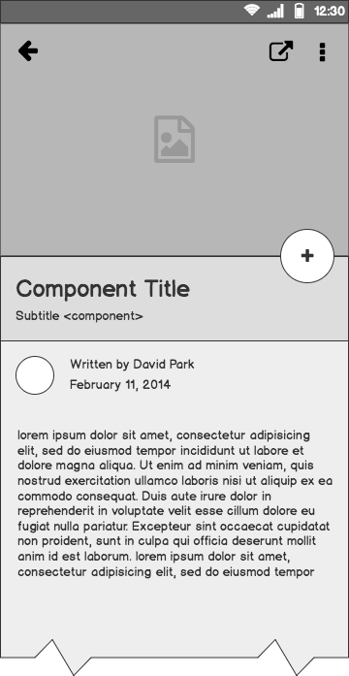
Smart ClassRoom
Empowering Classroom Efficiency Through Innovation
Team Members:
Raja Rajeswari Asetty – 999901332
Supraja Abburi – 999903003
Manogna Arla – 999902989
FNU Abdul Khadeer – 999902826
Akkineni Sai Krishna - 999903278

Slide 2
Problem statement
What customers do today
Inefficiencies in traditional classroom management at TechEd Academy
The inefficiencies and limitations in traditional classroom management practices hinder effective teaching and learning, leading to time wastage and reduced productivity for teachers and students. The lack of modern technological solutions like automated attendance tracking and remote appliance control further exacerbates the administrative burden, impacting the overall learning experience at TechEd Academy.
SmartClassroom Management System streamlines classroom tasks, enhances learning experience, and improves administrative efficiency at TechEd Academy.
Manual attendance tracking, limited appliance control, inefficient complaint handling, and disorganized file management create time wastage and administrative burdens for teachers and students at TechEd Academy.

Slide 3
Feasibility Report
Before embarking on the development of the Smart Classroom Management System, our team conducted a comprehensive feasibility study to assess the viability of the project. The study focused on three following key aspects:
Economic Feasibility
Technical Feasibility
Operational Feasibility

Slide 4
Functional
Requirements
Non-Functional
User Management
Login
Mark Attendance
Report Problem
File Management
Remote appliance control
Security and Access Control
Data Integrity and Accuracy
Performance Efficiency

Slide 5
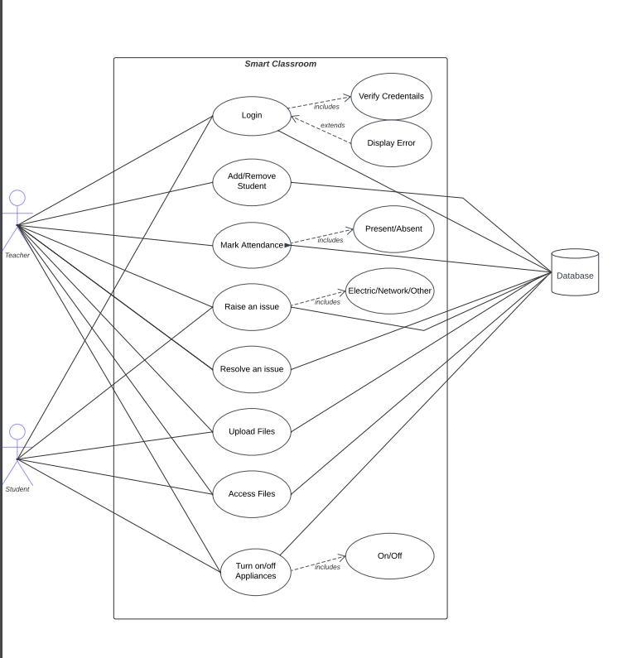
Use cases / user stories
As a teacher,
I want to mark attendance digitally.
I want to remotely control classroom appliances.
As a student
I want to access class materials online.
I want to report classroom issues easily.
As an administrator
I want to handle complaints efficiently.

Slide 6
Use Case Description
Use Case | Adding or Removing Student
Primary Actors | Teacher
Importance Level | High
Stake Holders | Teacher, Student
Brief Description | This use cases describes how to add a new student or remove an existing student from the application.
Trigger | New student has enrolled to class or Existing student left the class
Relationships | Association: New Student or Existing student Include: Student details Extends: Generalization: Manage students
Normal Flow of Events: | Adding Student: A new student enrolled in the class. Teacher must add the student in application. Remove Student: Existing students have left the class. Teacher must remove the student in application.

Slide 7
Solution description
The SmartClassroom Management System is a comprehensive and user-friendly platform that streamlines classroom tasks, improves administrative efficiency, and enhances the overall learning experience at TechEd Academy.
It offers features like digital attendance tracking, remote appliance control, efficient complaint handling, secure file storage, and easy problem reporting for teachers, staff, and students.

Slide 8
Why it’s better than existing solutions
SmartClassroom Management System excels over existing solutions with its digital attendance tracking, centralized file storage, and remote appliance control, enhancing efficiency and organization in classroom management.
Its user-friendly interface and scalability set it apart from fragmented solutions, providing a seamless and engaging learning experience for TechEd Academy's teachers, staff, and students.
By addressing multiple pain points, our system proves to be a superior and comprehensive platform for classroom management.

Slide 9
Design Pattern
For the SmartClassroom Management System, we have used the Model-View-Controller (MVC) pattern.
This design pattern divides the application into three parts: models for data and logic, views for the user interface, and controllers for data flow.
The MVC pattern ensures a clear separation of concerns, enabling independent development and maintenance of each component.

Slide 10
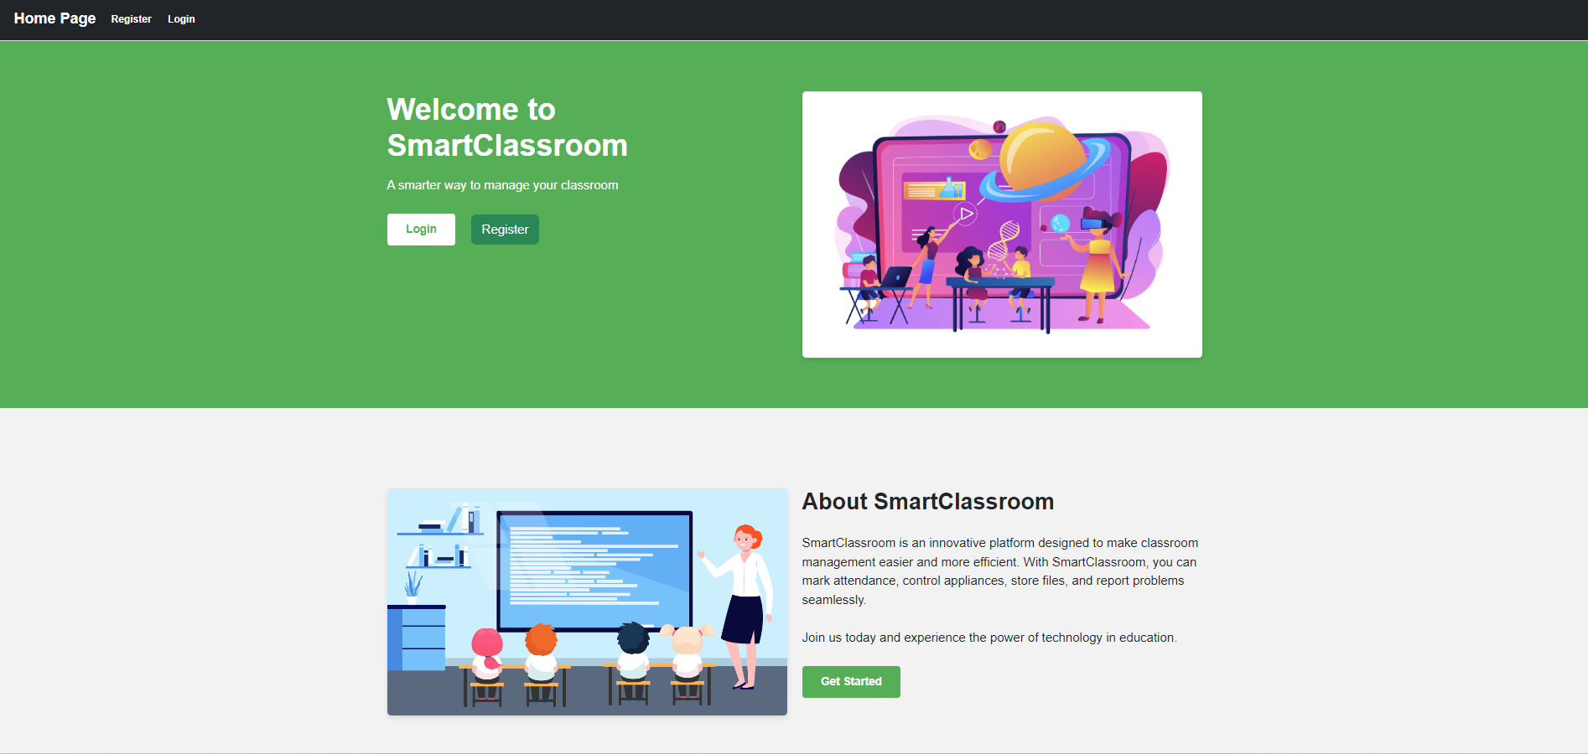
Component Browser
To create and enter rooms

Slide 11
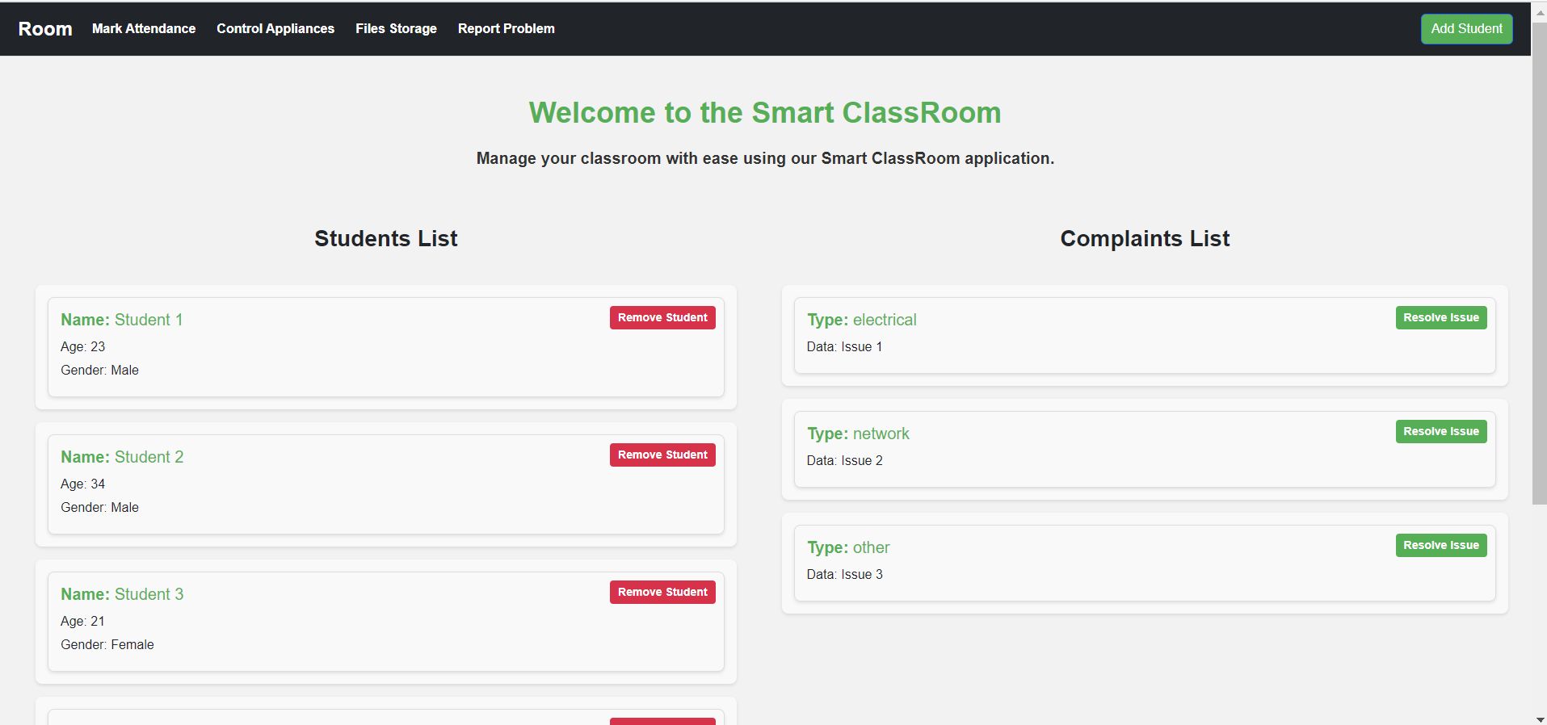
Home Page
Room Home Page

Slide 12
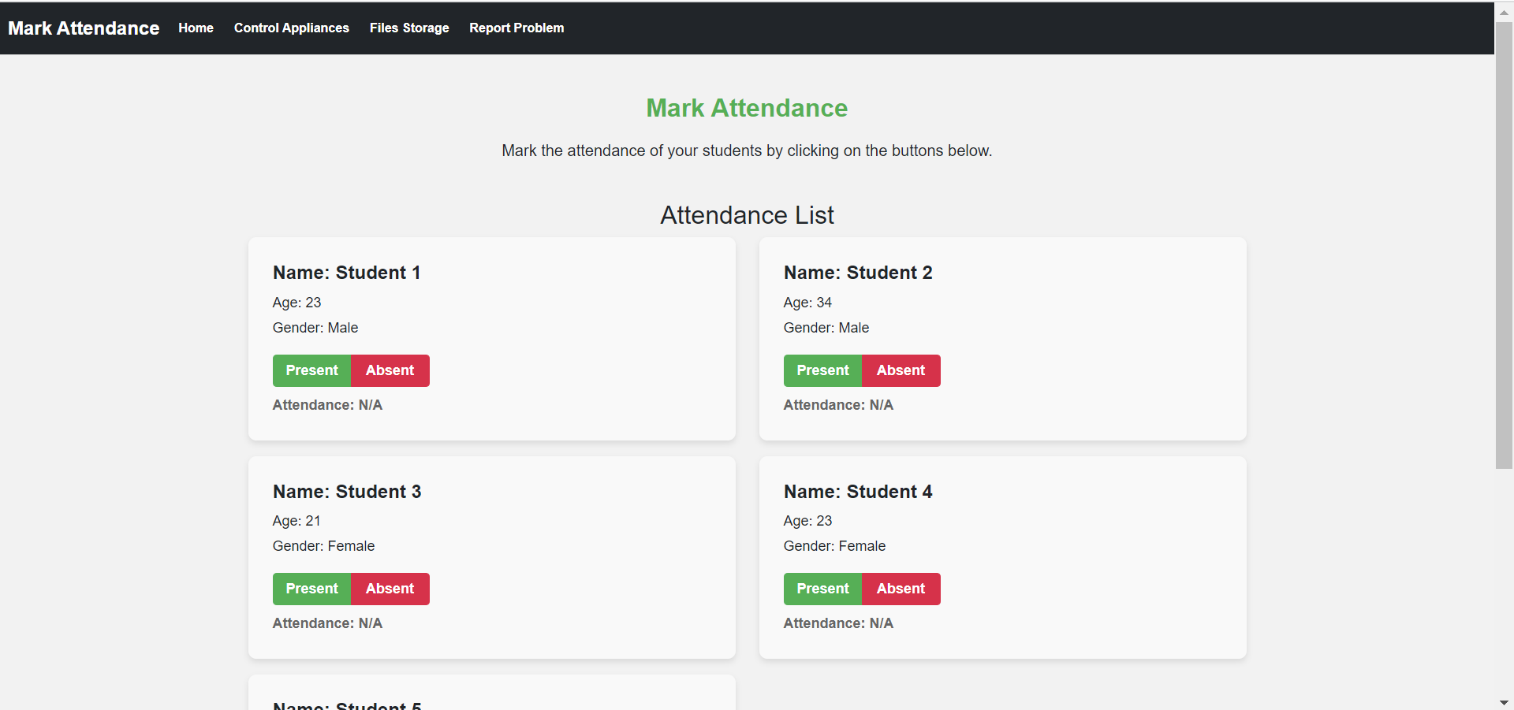
Mark Attendance
To mark attendance of students and donwlnoad it

Slide 13
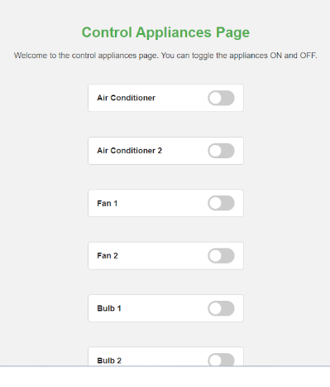
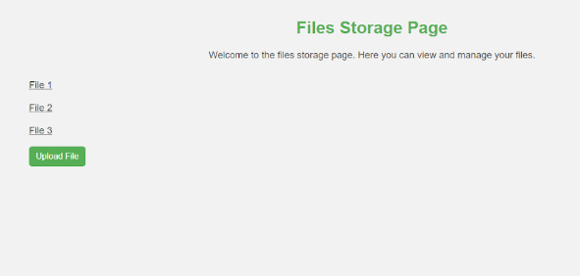
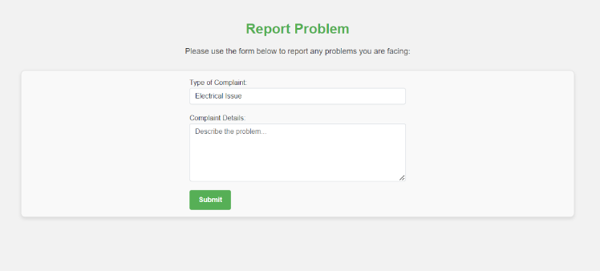
Report Problem

Slide 14
Stages
Testing Plan
Techniques
Unit Testing
Integration Testing
System Testing
User Acceptance Testing
Automated Testing
Load Testing
Compatibility Testing
Security Testing
Usability Testing
Regression Testing
Performance Testing

Slide 15
Thank You

